Slide 1
Lab-2 Introduction to Keil and Cortex Programming

Slide 2
Overview
Differences between microprocessor and Microcontroller
Keil : a cross Compiler
Concept of compiler
Why do we need cross compiler?
Development tools provided by keil
Cortex M0 development cycle
Basic Instruction set
Example programs

Slide 3
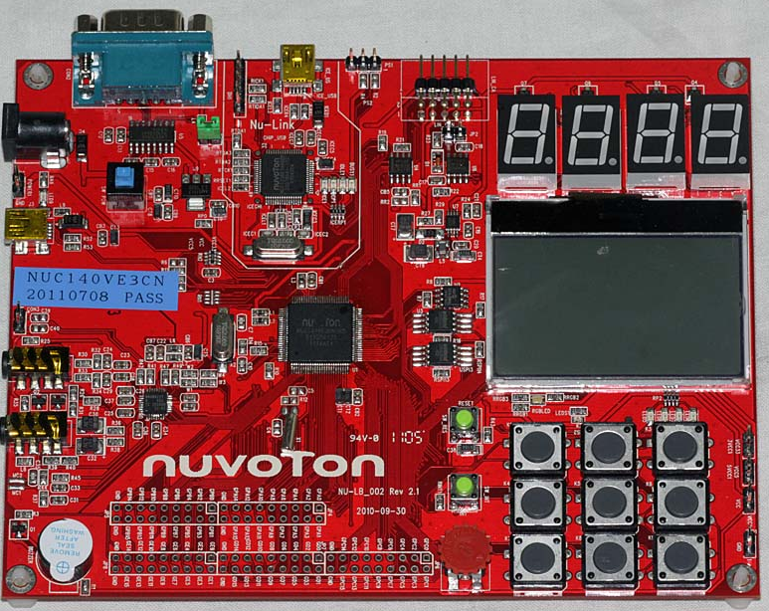
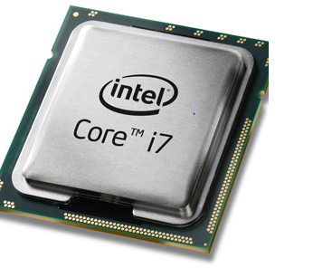
Differences between Microprocessor and a Microcontroller

Slide 4
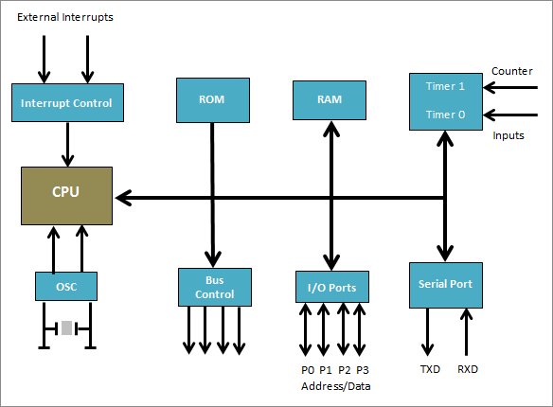
Microcontroller

Slide 5
Microcontroller
It’s like a small computer on a single IC.
It contains a processor core, ROM, RAM and I/O pins dedicated to perform various tasks.
Microcontrollers are generally used in projects and applications that require direct control of user.
it has all the components needed in its single chip, it does not need any external circuits to do its task
microcontrollers are heavily used in embedded systems and major microcontroller manufacturing companies are making them to be used in embedded market.
A microcontroller can be called the heart of embedded system.
Some examples of popular microcontrollers are 8051, AVR, PIC series of microcontrollers,.

Slide 6
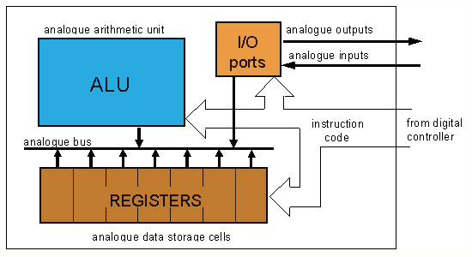
Microprocessor

Slide 7
Microprocessor
Microprocessor has only a CPU inside them in one or few Integrated Circuits.
Like microcontrollers it does not have RAM, ROM and other peripherals.
They are dependent on external circuits of peripherals to work.
But microprocessors are not made for specific task but they are required where tasks are complex and tricky like development of software’s, games and other applications that require high memory and where input and output are not defined.
It may be called heart of a computer system.
Some examples of microprocessor are Pentium, I3, and I5 etc.
Microprocessor have registers and ALU as processing unit and it does not have RAM, ROM in it.

Slide 8
Keil : A cross compiler
The Keil development Tools are designed to solve the complex problems facing embedded developers
Keil offers an evaluation package that will allow the assembly and debugging of files 2K or less.
This package is freely available at their website. Keil’s website address is www.keil.com

Slide 9
Concept of Compiler
Compilers are programs used to convert a high level language to object code.
So if one wants to define a compiler then compiler is a program that translates source code into object code
A cross compiler is similar to the compilers but we write a program for the target processor (like 8051 and its derivatives) on the host processors ( like computer of x86)
It means being in one environment you are writing a code for another environment is called cross development. And the compiler used for cross development is called cross compiler.

Slide 10
Why do we need cross compiler?
Development of complex embedded systems completed in a fraction of time
Reliability is improved
Maintenance is easy
Knowledge of the processor instruction set and memory architecture is not required
Improved program readability
Keywords and operational functions that more nearly resemble the human thought process can be used
Program development and debugging times are dramatically reduced
Existing routine can be reused in new programs by utilizing the modular programming techniques available in C.

Slide 11
Development tools provided by keil
IDE(Integrated development environment)
Project Manager
Simulator
Debugger
C cross compiler, Cross assembler, locator/ Linker.

Slide 12
An assembler is used to assemble your M0 or its derivatives assembly program.
A compiler is used to compile your C source code into an object file.
A linker is used to create an absolute object module suitable for your in-circuit emulator.

Slide 13
Cortex M0 development cycle
These are the steps to develop M0 project using keil.
Create source files in C or assembly
Compile or assemble source files
Correct errors in Source files
Link object files from compiler and assembler
Test linked application

Slide 14
Moving Data within the Processor: MOV/MOVS
MOV- instruction mnemonic for moving data is MOV
Syntax : MOV <Rd>, <Rm>
MOVS- to copy a register value to another and update the APSR at the same time, we could use MOVS/ADDS
Syntax: MOVS <Rd>, <Rm>
Updates APSR Z,N,C for ADDS
MOV- load an immediate data element into a register
Syntax: MOVS <Rd>, #immed8
Updates APSR Z, N

Slide 15
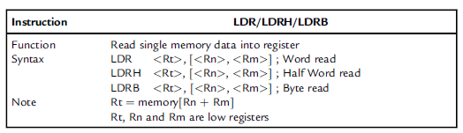
Memory Access Instructions: LDR, STR
LDR- Read single memory data into register.

Slide 16
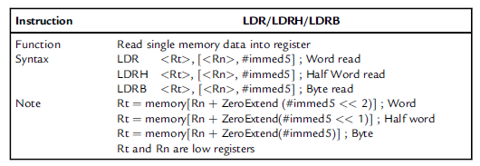
Memory Access Instructions: LDR, STR
LDR- The Cortex-M0 processor also supports immediate offset addressing modes

Slide 17
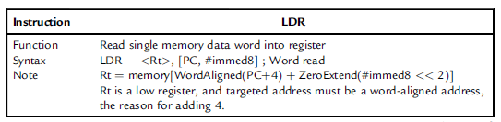
Memory Access Instructions: LDR, STR
LDR- PC relative load instruction for allowing efficient literal data accesses

Slide 18
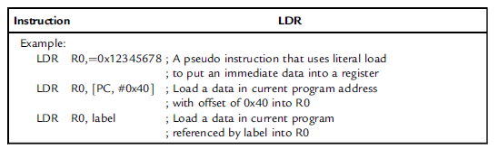
Memory Access Instructions: LDR, STR
LDR- PC relative load instruction for allowing efficient literal data accesses

Slide 19
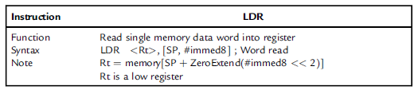
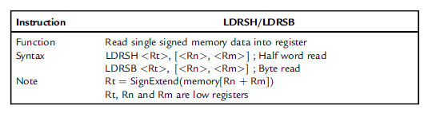
Memory Access Instructions: LDR, STR
LDR- PC relative load instruction for allowing efficient literal data accesses

Slide 20
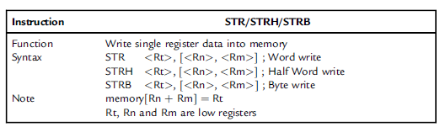
Memory Access Instructions: LDR, STR
STR- For single data memory writes, the instruction is STR (store)

Slide 21
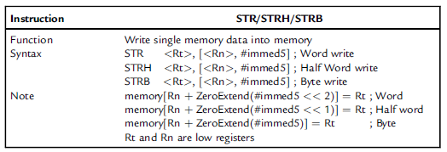
Memory Access Instructions: LDR, STR
STR- store operation supports an immediate offset addressing mode:

Slide 22
Arithmetic Operations: ADD
Add two registers:
ADD <Rd>,<Rn>,<Rm> →APSR update
Add an immediate constant into a register:
ADDS <Rd>,#immed8 →APSR update
Add two registers without updating APSR:
ADD <Rd>,<Rm>
Add stack pointer to a register without updating APSR:
ADD <Rd>, SP
Add stack pointer to a register without updating APSR:
ADD SP, <Rm>

Slide 23
Arithmetic Operations: ADD
Add stack pointer to a register without updating APSR:
ADD <Rd>, SP, #immed8 →(#immed8<<2)
Add an immediate constant to Stack pointer:
ADD SP, #immed8 →(#immed8<<2)
Add an immediate constant with PC to a register without updating APSR:
ADD <Rd>,PC,#immed8
Add with carry and update APSR:
ADCS <Rd>,<Rm>,<Rd>

Slide 24
Arithmetic Operations: SUB/MUL
Subtract two registers:
SUB <Rd>,<Rn>,<Rm>
Subtract a register with an immediate constant:
SUB <Rd>,<Rn>,#immed8
Subtract SP by an immediate constant:
SUB SP, #immed7
Subtract with carry:
SBCS <Rd>,<Rd>,<Rm>
Multiply:
MULS <Rd>,<Rm>,<Rd>
MUL <Rd>,<Rm>

Slide 25
Example 1: additon 32 bit
;additon 32 bit
PRESERVE8 ; Indicate the code here preserve
; 8 byte stack alignment
THUMB ; Indicate THUMB code is used
AREA |.text|, CODE, READONLY
EXPORT __main
; Start of CODE area
__main
MOVS R0, #4
MOVS R1, #3
ADDS R0, R0, R1
END

Slide 26
Example 2: addition 64 bit
;addition 64 bit
PRESERVE8 ; Indicate the code here preserve
; 8 byte stack alignment
THUMB ; Indicate THUMB code is used
AREA |.text|, CODE, READONLY
EXPORT __main
; Start of CODE area
__main
LDR r0,=0xFFFFFFFF ; X_Low (X = 0x3333FFFFFFFFFFFF)
LDR r1,=0x3333FFFF ; X_High
LDR r2,=0x00000001 ; Y_Low (Y = 0x3333000000000001)
LDR r3,=0x33330000 ; Y_High
ADDS r0,r0,r2 ; lower 32-bit
ADCS r1,r1,r3 ; upper 32-bit
stop B stop
END

Slide 27
Example 3: 64 bit subtraction
;64 bit substraction
PRESERVE8 ; Indicate the code here preserve
; 8 byte stack alignment
THUMB ; Indicate THUMB code is used
AREA |.text|, CODE, READONLY
EXPORT __main
; Start of CODE area
__main
LDR r0,=0x00000001 ; X_Low(X = 0x0000000100000001)
LDR r1,=0x00000001 ; X_High
LDR r2,=0x00000003 ; Y_Low(Y = 0x0000000000000003)
LDR r3,=0x00000000 ; Y_High
SUBS r0,r0,r2 ; lower 32-bit
SBCS r1,r1,r3 ; upper 32-bit
stop b stop
END

Slide 28
r1r0=00000000000000010000000000000001
r3r2=00000000000000000000000000000011
ans=000000000000000001111111111111110

Slide 29
Example 4: swap
PRESERVE8 ; Indicate the code here preserve
; 8 byte stack alignment
THUMB ; Indicate THUMB code is used
AREA |.text|, CODE, READONLY
EXPORT __main
; Start of CODE area
__main
LDR R0,=0XF631024C
LDR R1,=0X17539ABD
EORS R0,R0,R1 ;R0^R1
EORS R1,R0,R1 ;R1^R0
EORS R0,R0,R1 ;R0^R1
stop B stop ;stop program
END

Slide 30
Exercise
Complete the Lab_data_sheet_2

